Slide 1
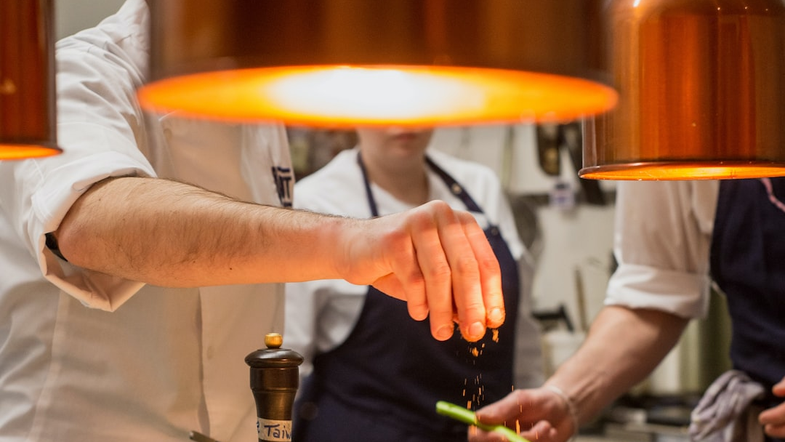

"You are what you eat."

Slide 2




Software Engineering Project
Serra Nur AKMESE
Arda BOZKURT
Steve FOFOU LONTCHI

Slide 3
Agenda
Introduction and feasibility study
Requirements and specifications
Implementation
Testing
Live Demo
Conclusion

Slide 4
Introduction and Feasibility Study

Slide 5

The Problem: Challenges in Student Cooking
Lack of knowledge and experience in meal preparation.
Limited time due to busy schedules.
Limited access to ingredients due to budget constraints or living arrangements.
Desire for delicious, healthy, and homemade food as part of a balanced lifestyle.

Slide 6
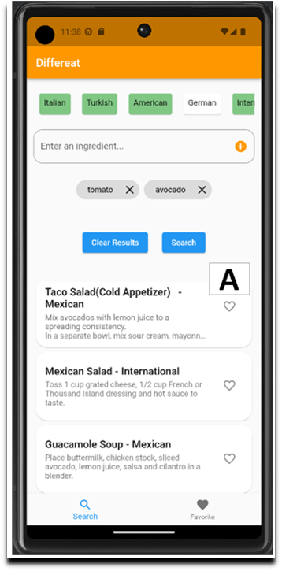
THE SOLUTION : Differeat
Your Cooking Companion
User-friendly
Input available ingredients.
Select preferred cuisines.
Receives 5 quick and easy recipes.
Recipes from reliable sources and are beginner-friendly.
Prioritizes recipes under 30 minutes with minimal prep and cleanup.
Suggests recipes with basic ingredients and easy-to-find extras.
Flexibility for ingredient substitution.
Additional features include saving favorites, creating shopping lists, and social sharing.

Slide 7

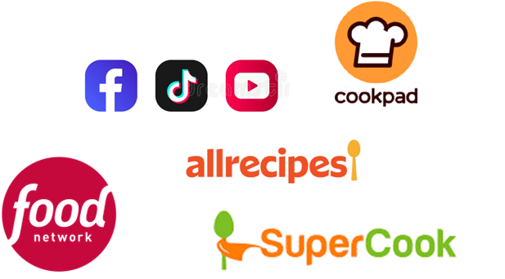

Assesing The Landscape
Competitor Analysis
"Differeat" Stands Out
AI Generative Models
Classic Cooking Websites
Social Media Influencers
Recipe Apps
Created by students, for students.
Budget-friendly
Easy-to-make
Flexible recipes.
Address time constraints and limited ingredients.
Simple user interface.
Future features: meal planning, grocery lists, and social sharing.

Slide 8
The Project Scope
Prototype Objectives:
Potential Further Features:
User Input: Input available ingredients through a user-friendly interface with a predefined ingredient list.
Recipe Matching: Implement a matching algorithm for user-inputted ingredients.
Recipe Display: Show the top 5 matching recipes with details.
Cuisine Selection: Enable users to choose cuisine preferences.
Basic User Management: Include user registration and login.
Favourite Recipes: Users can save preferred recipes.
Search History: Access to previous searches.
Personalization: Dietary preferences for personalized recommendations.
Notifications: Alerts for new recipes and updates.
Nutritional Information: Display recipe nutritional details.
Shopping List: Generate shopping lists.
Admin Management Section: Administrative control over users, ingredients, and recipes.

Slide 9
Requirements and Specifications​
​

Slide 10
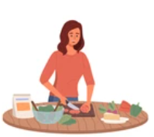



Exploring User Scenarios
Scenario 1: Maria's Dinner Adventure
Scenario 2: Jason's Meal Planning
Scenario 3: Paolo's Culinary Journey
Scenario 4: Greta's Dietary Exploration
Maria installs the "Differeat".
Creates an account and logs in.
Inouts ingredients and cuisine preference.
Receive 5 recipe suggestions.
Selects a recipe and enjoys her meal.
Jason logs into "Differeat".
Uses the "Shopping List" feature.
Reviews, adds, and specifies ingredients.
Generates a shopping list.
Shops for ingredients and checks them off.
Paolo, a cooking enthusiast, uses "Differeat".
Saves favorite recipes.
Manages notifications and preferences.
Accesses detailed nutritional info.
Enhances his cooking experience.
Greta logs in and sets dietary preferences.
Searches for recipes with available ingredients.
Receives top 5 suitable recipes.
Prepares a meal meeting her dietary need

Slide 11
Use Cases
From the scenario 1,
we retrieve these use cases:
Sign Up User
Login
Input Ingredients
Select a cuisine
Choose a Recipe
UC4 | Select a cuisine
Actors | User
Entry Condition | The user has already inputted ingredients
Flow of Events | 1. User select none, one or more type of cuisine 2. User submits his selection to the application
Exit Condition | The application receives the user's inputted cuisine and filters matching recipes.
Exceptions | If the user selects an invalid or non-existent cuisine, the application displays an error message and prompts the user to select a valid cuisine

Slide 12
Key Functional Requirements 1/2
The requirements implemented on the prototype:
S1 - User Input (R1 - R4)
R1: Users select ingredients from a predefined list.
R2: Matching algorithm pairs ingredients with recipes.
R3: Prioritize recipes with more matching ingredients.
R4: Consider user's cuisine preference.
S2-Recipe Matching:
R2 - The application should have a matching algorithm that takes the user-inputted ingredients and matches them with recipes in a database.
R3 - The matching algorithm should prioritize recipes that have a higher number of matching ingredients.
R4 - The matching algorithm should consider the cuisine preference selected by the user, if any.
S3 - Recipe Display (R5, R6)
R5: Display the top 5 matching recipes.
R6: Show recipe name, ingredients, instructions, and cooking time.

Slide 13






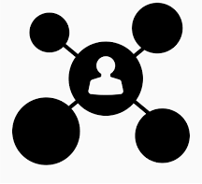

Non Functional Requirements
Usability: Prioritizes user experience, efficiency, and user engagement.
Performance: Emphasizes responsiveness, scalability, and efficient navigation.
Reliability: Ensures high uptime, data integrity, and robust error handling.
Supportability: Offers easy maintenance, bug tracking, and user support.
Implementation: Focuses on technology, coding standards, and efficiency.
Security and Privacy: Implements strong security measures and data protection.
Packaging: Ensures easy distribution, installation, and updates.
Interface: Provides an intuitive, accessible, and user-friendly design.

Slide 14
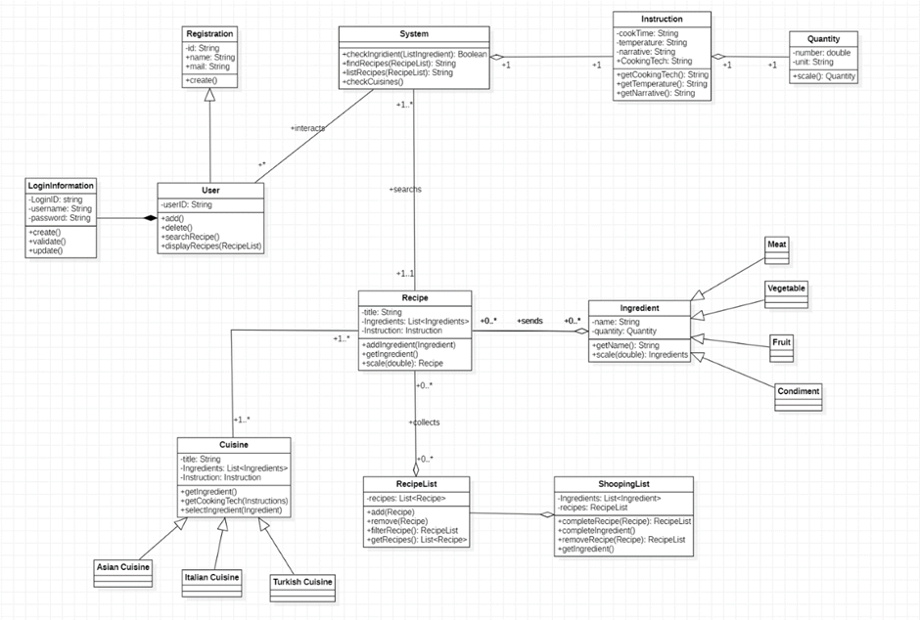
Class Diagram

Slide 15
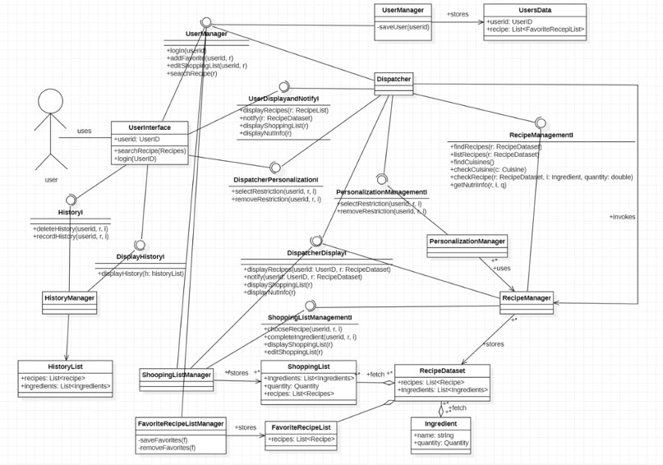
UML Architecture

Slide 16
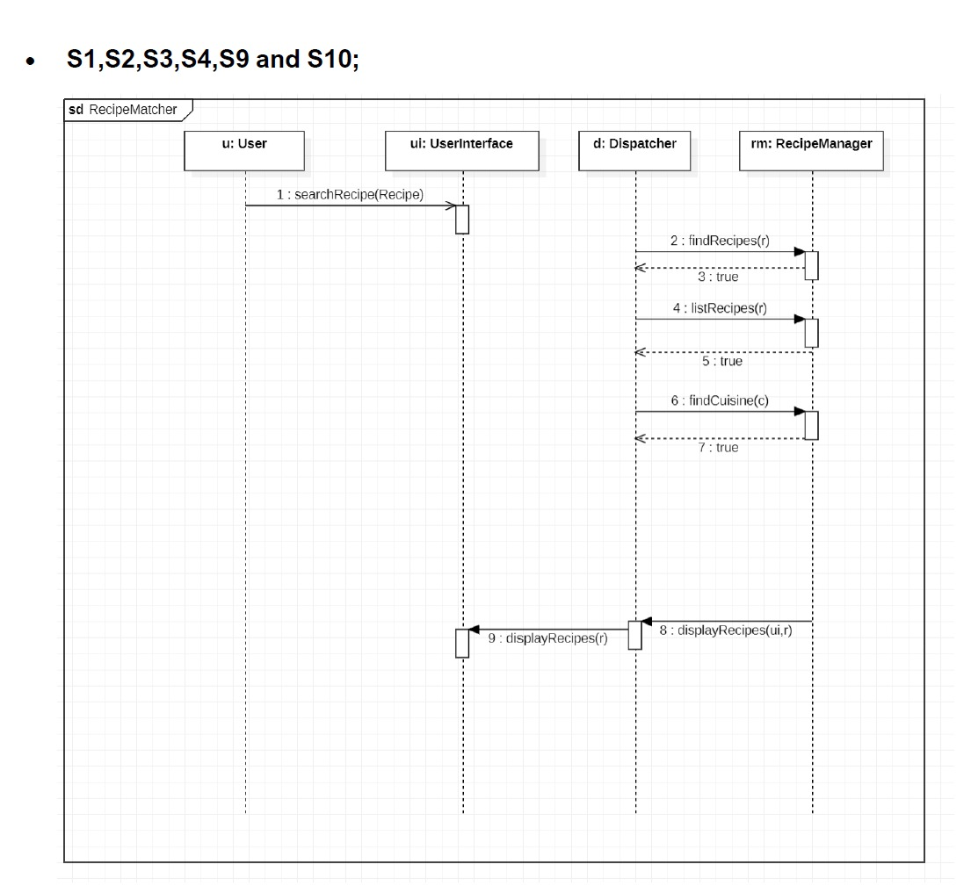
Sequence Diagrams

Slide 17
Implementation​

Slide 18

Why Flutter Framework?
2. Dart Programming Language
1. Flutter Framework
Single Codebase, Multiple Platforms
Native Performance
Wide Range of Widgets
Hot Reload
UI Consistency
Object-Oriented Approach
Strongly Typed for Safety
Async Programming with Ease
Expressive and Readable Code
Growing Community and Google Support

Slide 19
Iterative Development Approach for "Differeat"
First Phase
Next Phase
Scope S1 - User Input
Scope S2 - Recipe Matching
Scope S3 - Recipe Display
Scope S4 - Cuisine Selection
Scope S6 - Favourite Recipes​
​
Scope S5- Basic User Management​
Scope S8- Personalization​
Scope S10- Nutritional Information: ​
Scope S11 – Shopping List​
Scope S12- Quantity Management

Slide 20

Code Structure of "Differeat"
1. App_state Class​
2. Recipe_model Class​
3. Recipe_Manager Class​
4. Favorite_Manager Class​
5. Screens Classes​
Search: Find recipes by ingredients and cuisine.​
Recipe: Display detailed recipe information.​
Home: Main application screen with navigation.​
Favorite: Display favorite recipes.​
6. Main Class

Slide 21
Testing

Slide 22
Testing Cases
1. FAIL
1. PASS
​Sign Up User (UC1)​
Result: Fail​
Observation: User registration not implemented.
Login (UC2)​
Result: Fail​
Observation: User login not implemented.​
Basic User Management (UC1, UC2, R9, R10 - S5)​
Result: Fail​
Observation: User registration, login, and account update not functioning.​
​Cuisine Selection (UC4, R7, R8 - S4)​
Result: Pass​
Observation: Users can select cuisines and view corresponding recipes.​
Choose a Recipe (UC5, R5, R6 - S3)​
Result: Pass​
Observation: Recipe details are displayed accurately.​
Input Ingredients and Recipe Matching (UC3, R1 - S1, R2, R3, R4 - S2)
Result: Pass
Observation: Ingredient input and recipe matching function properly.

Slide 23

Next Step
Address issues with user registration and login.​
Continue refining ingredient input and recipe matching.​
Enhance cuisine selection and recipe display.​
Prioritize user management functionalities for a complete user experience.

Slide 24
Conclusion

Slide 25

Conclusion
Goal: Create cooking app​
Key features: ingredient selection and recipe matching. ​
Flutter and Dart ​
Iterative development principles, design, testing, and refinement. ​
Technical skills, learned about teamwork and project management, and documentation.​

Slide 26

Thank you
QUESTIONS & ANSWER

Slide 27
Live Demo

